Slide 1



System Analysis and Design
Project Management and Information Gathering

Slide 2
Motivation
System Analyst
Planning & managing activities
Determining project feasibility
Scheduling projects
Initiating projects
Planning & managing team members
Project management fundamentals

Slide 3

Motivation
Analysts work with users to create a problem definition reflecting current business systems and concerns.

Slide 4

Motivation
If a project is approved, activities are scheduled using tools:
Gantt charts
Program Evaluation and Review Techniques (PERT)

Slide 5
Objectives
Understand what is Gantt chart
Understand what is PERT diagram
Understand what is Fishbone diagram
Understand how system analyst gather information
Interviewing
Questionnaire

Slide 6
Content
Gantt chart
PERT diagram
Fishbone diagram
Interviewing
Questionnaire

Slide 7
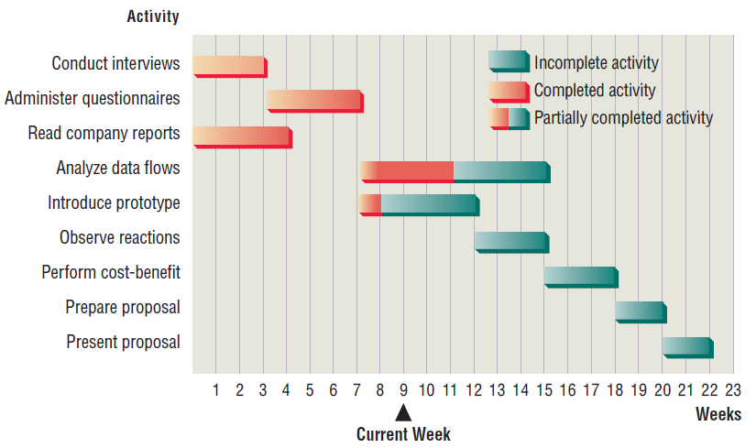
Gantt Chart
A Gantt chart is a chart to schedule tasks.
Bars represent each task or activity.
The length of each bar represents the relative length of the task.

Slide 8
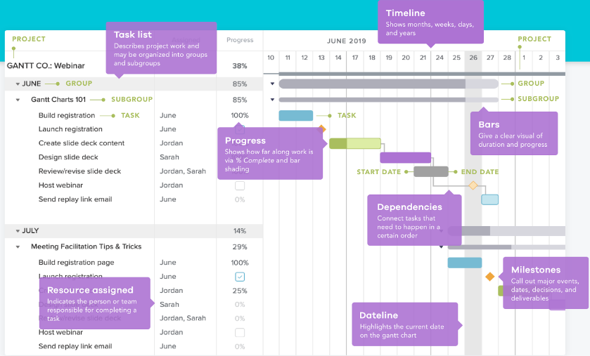
Gantt Chart
Basic elements
Task list
Timeline
Dateline
Bars
Milestones
Dependencies
Progress
Resource assigned

Slide 9
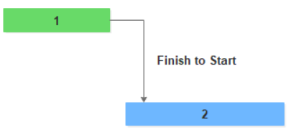
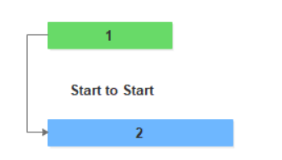
Gantt Chart
Task dependency
Finish to Start: Task 2 can't start before task a is finished.
Start to start: Task 2 can't start before task 1 starts.

Slide 10
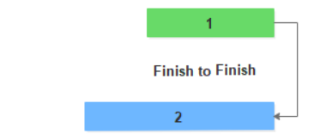
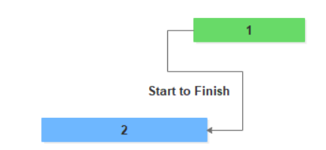
Gantt Chart
Task dependency
Finish to finish: Task 2 can't finish before task 1 is finished.
Start to finish: Task A can't finish before Task B starts.

Slide 11
Content
Gantt chart
PERT diagram
Fishbone diagram
Interviewing
Questionnaire

Slide 12
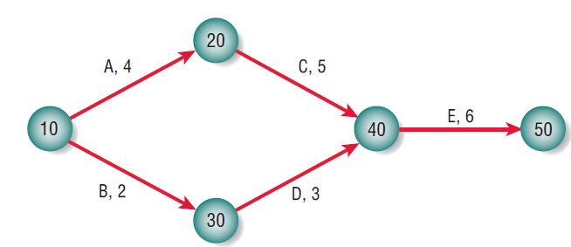
PERT Diagram
PERT = Program Evaluation and Review Techniques.
A network of nodes and arrows that are then evaluated.
Determine the critical activities
Improve the schedule if necessary
Review progress once the project is undertaken.

Slide 13
PERT Diagram
An arrow represents an activity.
Circles represent events (identified by numbers, letters).
Activity C may not be started until activity A is completed.
To find the length of the project, calculate the sum of the durations of each event.

Slide 14
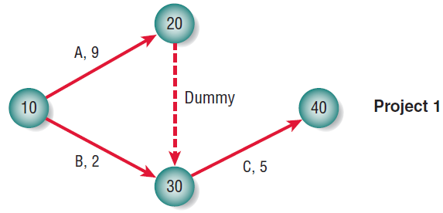
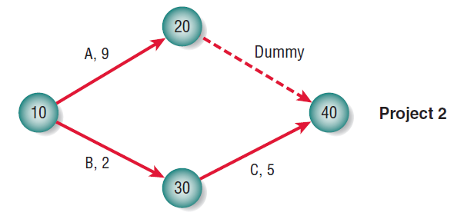
PERT Diagram
PERT diagrams need pseudo-activities, referred to as dummy activities, to preserve the logic of or clarify the diagram.
In project 1 activity C can only be started if both A and B are finished.
In project 2, activity C requires only activity B’s completion and can therefore be under way while activity A is still taking place.

Slide 15
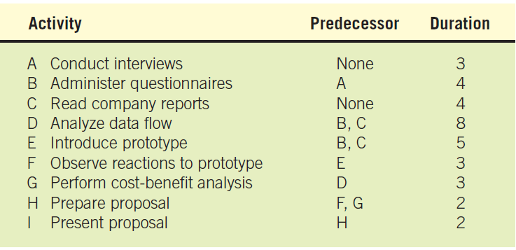
PERT Diagram
Example
In constructing the PERT diagram, the analyst looks first at those activities requiring no predecessor activities, in this case A (conduct interviews) and C (read company reports).

Slide 16
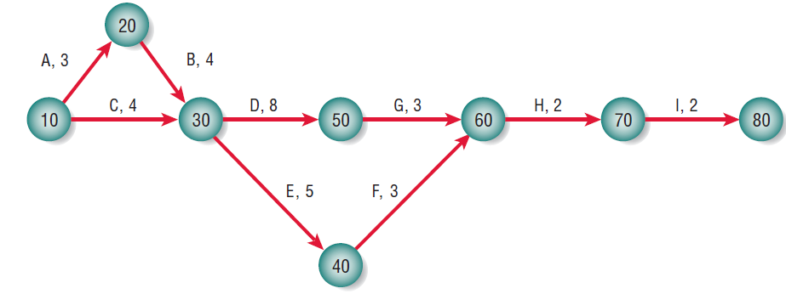
PERT Diagram

Slide 17
Content
Gantt chart
PERT diagram
Fishbone diagram
Interviewing
Questionnaire

Slide 18
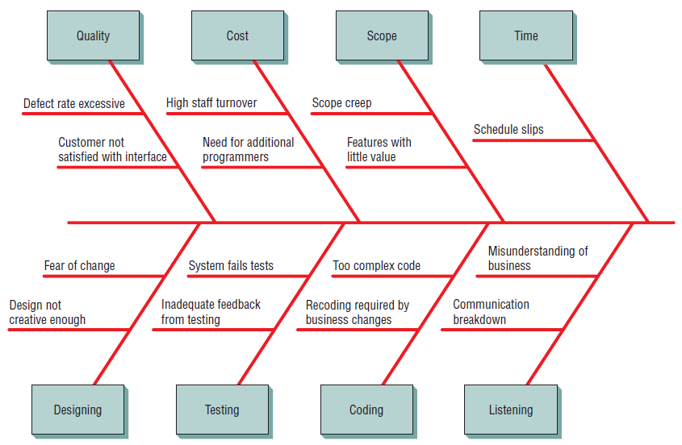
Fishbone Diagram
Fishbone diagram is used to illustrate what can go wrong in a project.
also called a cause-and-effect diagram or an Ishikawa diagram.

Slide 19
Content
Gantt chart
PERT diagram
Fishbone diagram
Interviewing
Questionnaire

Slide 20
Interviewing
An information-gathering interview is a directed conversation with a specific purpose that uses a question-and-answer format.
In the interview you want to get
The opinions of the interviewee
His/her feelings about the current state of the system organizational
Personal goals, and informal procedures for interacting with information technologies.

Slide 21
Interviewing
The interview is also a valuable time to explore key HCI (human–computer interaction) concerns.
Ergonomic aspects
System usability
In the interview you are setting up a relationship with someone who is probably a stranger to you.
You need to build trust and understanding quickly, but at the same time you must maintain control of the interview.

Slide 22
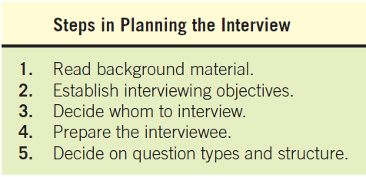
Interviewing
Steps to prepare an interview

Slide 23
Interviewing
Question types
OPEN-ENDED
CLOSED
PROBES

Slide 24
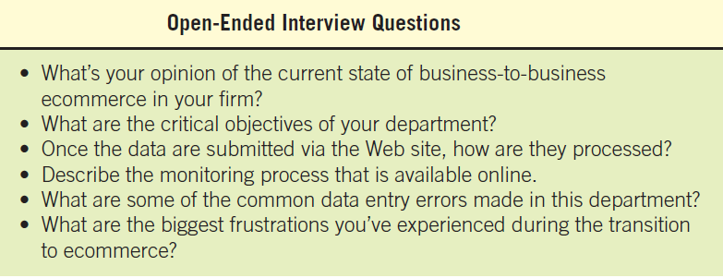
Interviewing
Open-ended Questions Examples

Slide 25
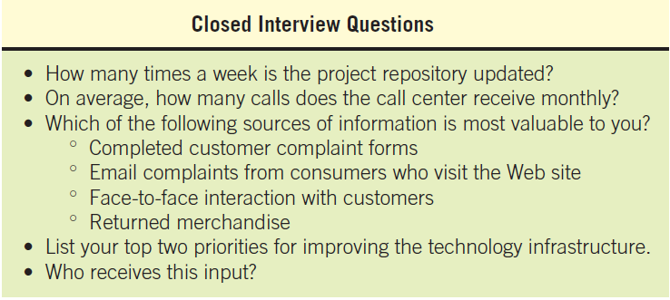
Interviewing
Closed Questions Examples

Slide 26
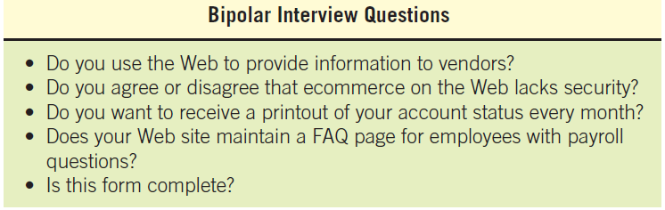
Interviewing
A special kind of closed question is the bipolar question. This type of question limits the interviewee even further by only allowing a choice on either pole.
Such as yes or no, true or false, agree or disagree.

Slide 27
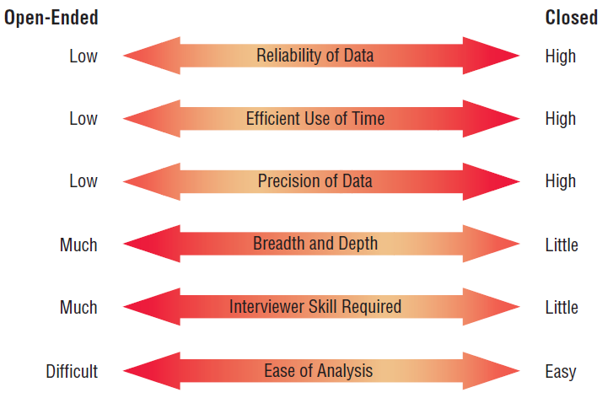
Interviewing
Open ended vs closed questions

Slide 28
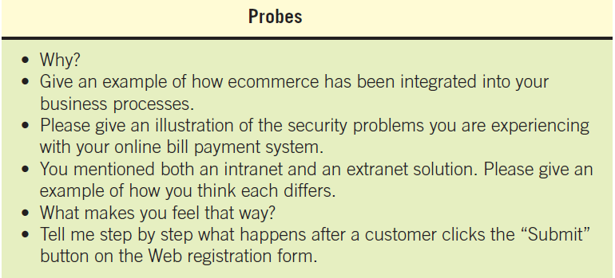
Interviewing
PROBES examples:
Probes allow the systems analyst to follow up on questions to get more detailed responses.

Slide 29
Content
Gantt chart
PERT diagram
Fishbone diagram
Interviewing
Questionnaire

Slide 30
Questionnaire
Questionnaire is an information-gathering technique that allows systems analysts to study
Attitudes, what people in the organization say they want
Beliefs, what people think is true
Behaviour, what organizational members do
characteristics of several key people in the organization

Slide 31
Questionnaire
Consider using questionnaires if:
The people you need to question are widely dispersed (different branches of the same corporation).
A large number of people are involved in the systems project, and it is meaningful to know what proportion of a given group approves or disapproves of a particular feature of the proposed system.
You are doing an exploratory study and want to gauge overall opinion before the systems project is given any specific direction.
You wish to be certain that any problems with the current system are identified and addressed in follow-up interviews.

Slide 32
Questionnaire
The biggest difference between the questions used for most interviews and those used on questionnaires is that interviewing permits interaction between the questions and their meanings.
The basic question types used on the questionnaire are
open-ended
closed

Slide 33
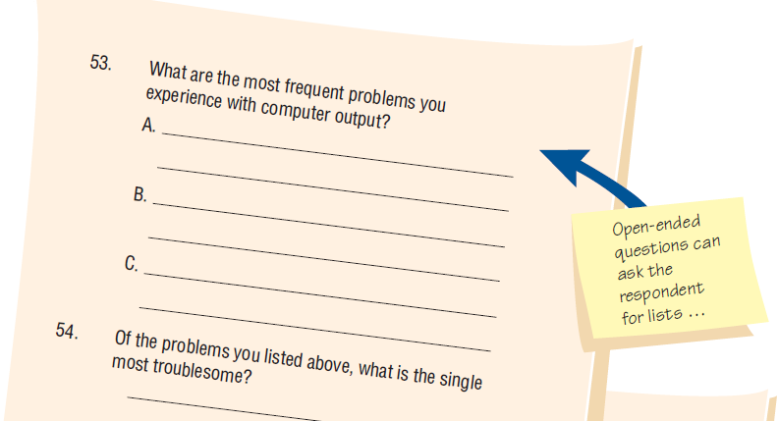
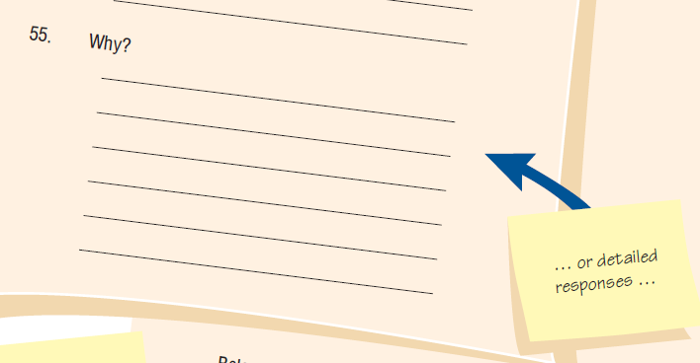
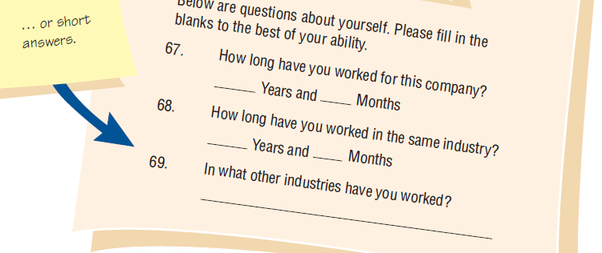
Questionnaire

Slide 34
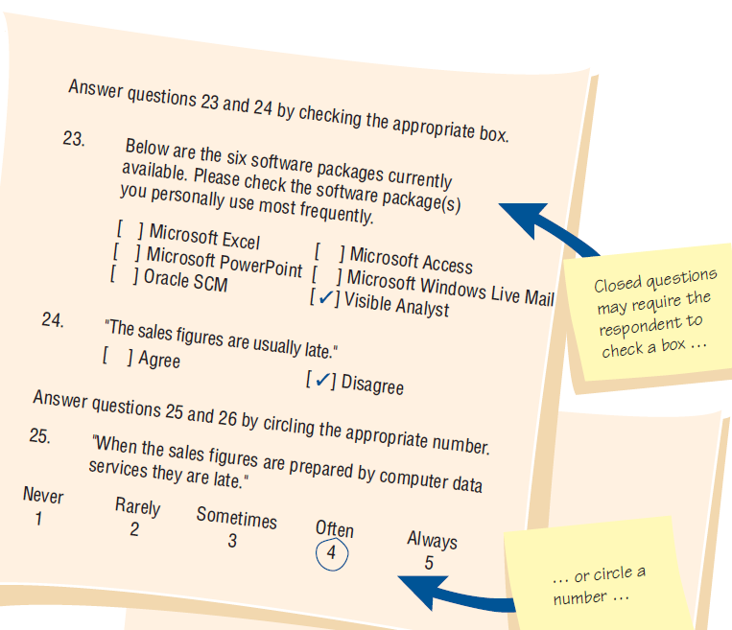
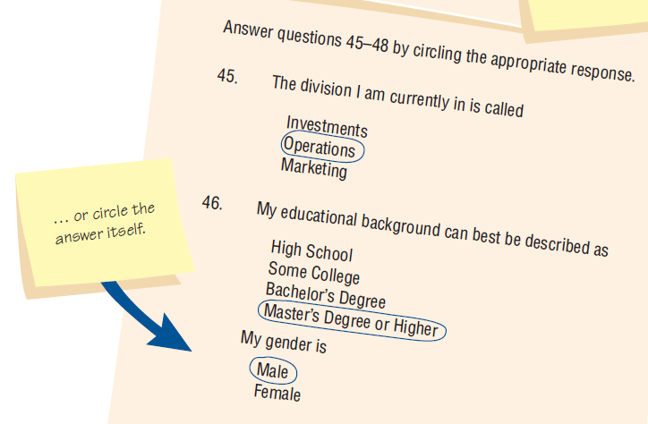
Questionnaire

Slide 35
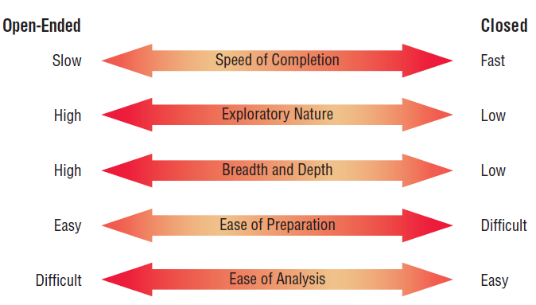
Questionnaire
Trade-offs between the use of open-ended and closed questions on questionnaires.

